Slide 1



Customer Data Anaylsis
Customer data analysis helps businesses understand customer behavior, preferences, and buying patterns using collected data. It identifies trends such as most purchased products, high-value customers, and peak sales periods. This analysis supports better decision-making in marketing, inventory, and customer service. Overall, it improves customer satisfaction and increases business profitability.
Presented By : Yuvaraj Bagi

Slide 2
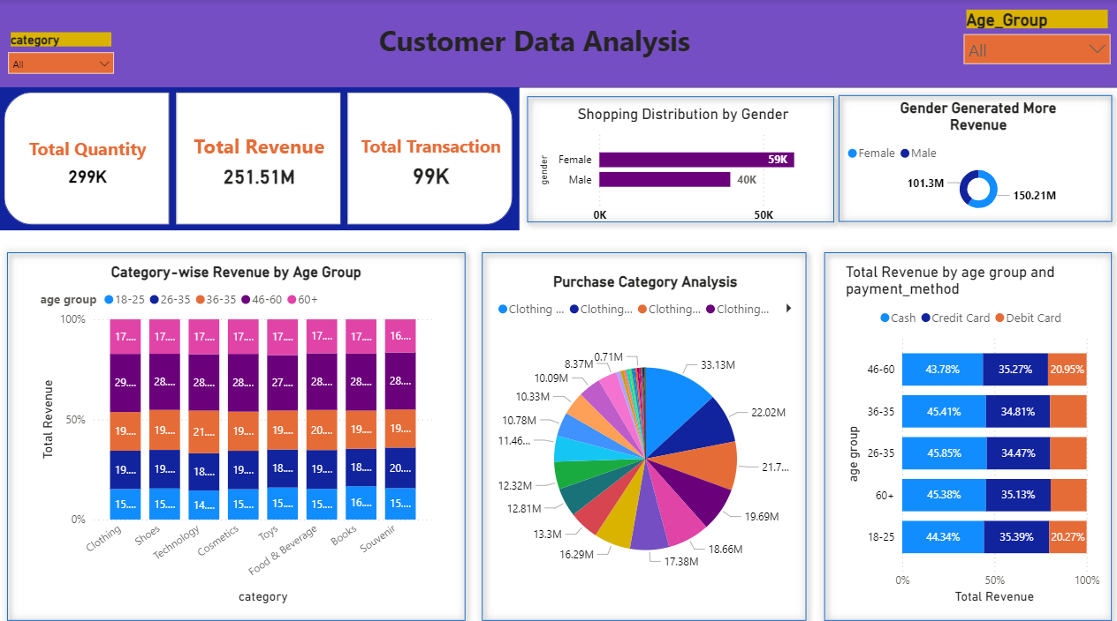
Customer Data Analysis Dashboard

Slide 3




Project overview
This project focuses on analyzing customer data to understand purchasing behavior, preferences, and trends. It examines factors like age, gender, product categories, and payment methods to identify patterns in sales and revenue. The goal is to provide useful insights for improving business decisions, marketing strategies, and customer experience.
In this project, SQL is used to extract, filter, and transform data from the database, while Power BI is used to create interactive dashboards and visual reports. These reports help stakeholders easily understand sales performance and customer patterns. The project supports data-driven decision-making using reliable queries and clear visualizations.

Slide 4
Dataset Architecture
invoice_no: A combination of the letter 'I' and a 6-digit integer uniquely assigned to each operation.
customer_id: A combination of the letter 'C' and a 6-digit integer uniquely assigned to each operation.
gender: String variable of the customer's gender.
age: Positive Integer variable of the customer’s age.
category: String variable of the category of the purchased product.
quantity: The quantities of each product (item) per transaction.
price: Product price per unit in Turkish Liras (TL).
payment_method: String variable of the payment method (cash, credit card or debit card) used for the transaction.
invoice_date: The day when a transaction was generated.
shopping_mall: String variable of the name of the shopping mall where the transaction was made

Slide 5




Key Performance Indicators
2,51,505.79K
Total Revenue
99457
Total Orders
298712
Total Quantity
2,529
Average Order Value
1
Total Revenue Aggregate income generated from all customer transactions during the analysis period
2
Total Orders Count of unique purchase transactions recorded across all channels
3
Total Quantity
Sold Sum of all individual items sold across every transaction
4
Average Order Value
Count of unique purchase transactions recorded across all channels

Slide 6
Customer Insights
Demographics Drive Revenue :
Customer segmentation analysis reveals significant patterns in purchasing behavior across gender and age groups.
Female customers lead in revenue:
Women generate higher total revenue and purchase more items per transaction on average
Age group 46–60 dominates spending :
This demographic contributes the highest revenue share, representing peak earning and spending years
Younger and older segments lag :
Ages 18–25 and 60+ show notably lower spending behavior, presenting growth opportunities

Slide 7
Category Insights
Top Performer: Clothing Clothing dominates revenue generation, representing the strongest product category with consistent highvolume sales
Strong Contributors :Shoes and Technology rank as the next best-performing categories, showing healthy demand and growth potential
Underperformers: Books, Souvenirs, Food & Beverage, and Toys demonstrate lower purchase volumes, requiring strategic intervention

Slide 8
Shopping mall Insights
1 Top Performers: Mall of Istanbul & Kanyon Our leading locations, consistently achieving the highest sales volumes and customer engagement.
2 Medium Performers: Metrocity & Metropol AVM Demonstrating healthy demand and contributing steadily to our regional revenue
3 Lower Performers: Remaining Malls Exhibit lower purchase volumes and consistent sales trends, indicating areas that require strategic intervention and targeted improvement.

Slide 9
Payment Method Insights
3rd
Debit Card
Lags Contributes the smallest share of payment methods
2nd
Credit Cards Rising Second most popular with growing adoption rates
44.86%
Cash Dominates Most preferred payment method across all transactions
Despite the digital transformation trend, cash remains king in customer transactions. Credit card usage shows promising growth momentum, suggesting an opportunity to incentivize digital payment adoption through loyalty programs and targeted promotions.

Slide 10
Revenue Trends Over Time
1
2021: Stable Performance Revenue maintained consistent levels throughout the year with predictable seasonal patterns
2
2022: Continued Stability Similar performance to 2021, showing business resilience and steady customer engagement
3
2023: Sharp Decline Critical revenue drop signals urgent need for investigation into market conditions, operational issues, or competitive pressures
Action Required: The 2023 revenue decline demands immediate analysis to identify root causes—whether market-driven, operational, or competitive—and develop recovery strategies.

Slide 11

Strategic Recommendations & Conclusion
Key Action Items
1 Target High-Value Segments:
Focus marketing on age 46–60 and female customers who drive the most revenue
2 Accelerate Digital Payments :
Implement incentives to shift customers from cash to credit/debit cards
3 Revitalize Weak Categories :
Develop targeted campaigns for Books, Souvenirs, Food & Beverage, and Toys
4 Optimize Store Portfolio :
Replicate success factors from top malls; consider restructuring underperformers
5 Investigate 2023 Decline:
Conduct deep-dive analysis to understand and reverse the revenue drop
Project Impact :This analysis demonstrates the power of combining MySQL and Power BI to transform raw transactional data into strategic business intelligence. By uncovering patterns in customer behavior, product performance, and sales trends, we've provided a data-driven foundation for revenue optimization and operational excellence.

Slide 12


